Slide 1
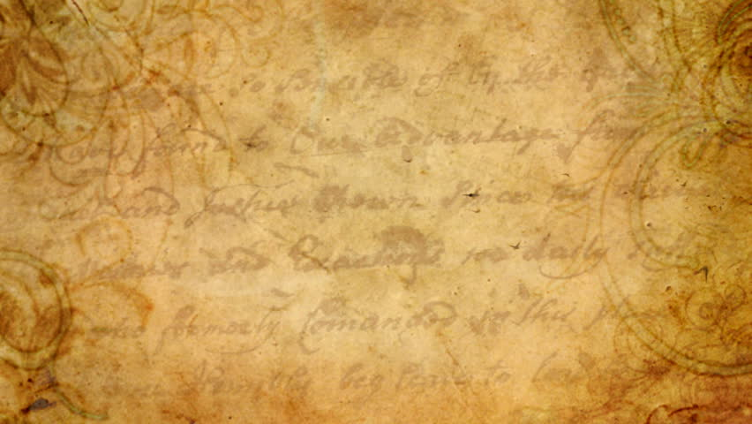
Summer Term 1 in Year 3
English
Maths
Welcome back!
Our topic for this term is 'Amersham'.
Dates for your diaries:
PE days – Monday + Friday
29.4.24 - Benchball at The Amersham School
8.4.24 / 9.4.24 Trip to the Amersham Museum
Our book focus for this half term will be 'The Firework Maker's Daughter'.
Writing lessons will focus on language choices and sentence structure. We will be writing to discuss (balanced argument) and to persuade (letter).
This half term we will learn:
Fractions (adding and subtracting fractions)
Money (including converting pounds and pence)
Time (reading analogue and digital time)
Science
History
Our unit this half term is forces and magnets. We will be learning about friction and magnetism as forces.
We will learn about the history of Amersham, how it has changed and the impact of the coming of the railway.
Reading
Please ensure that all reading is logged on BoomReader a minimum of 3 times a week.

Slide 2
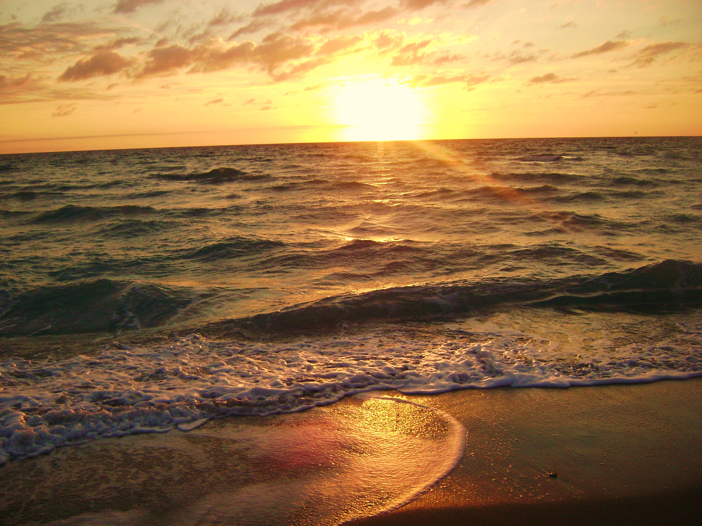
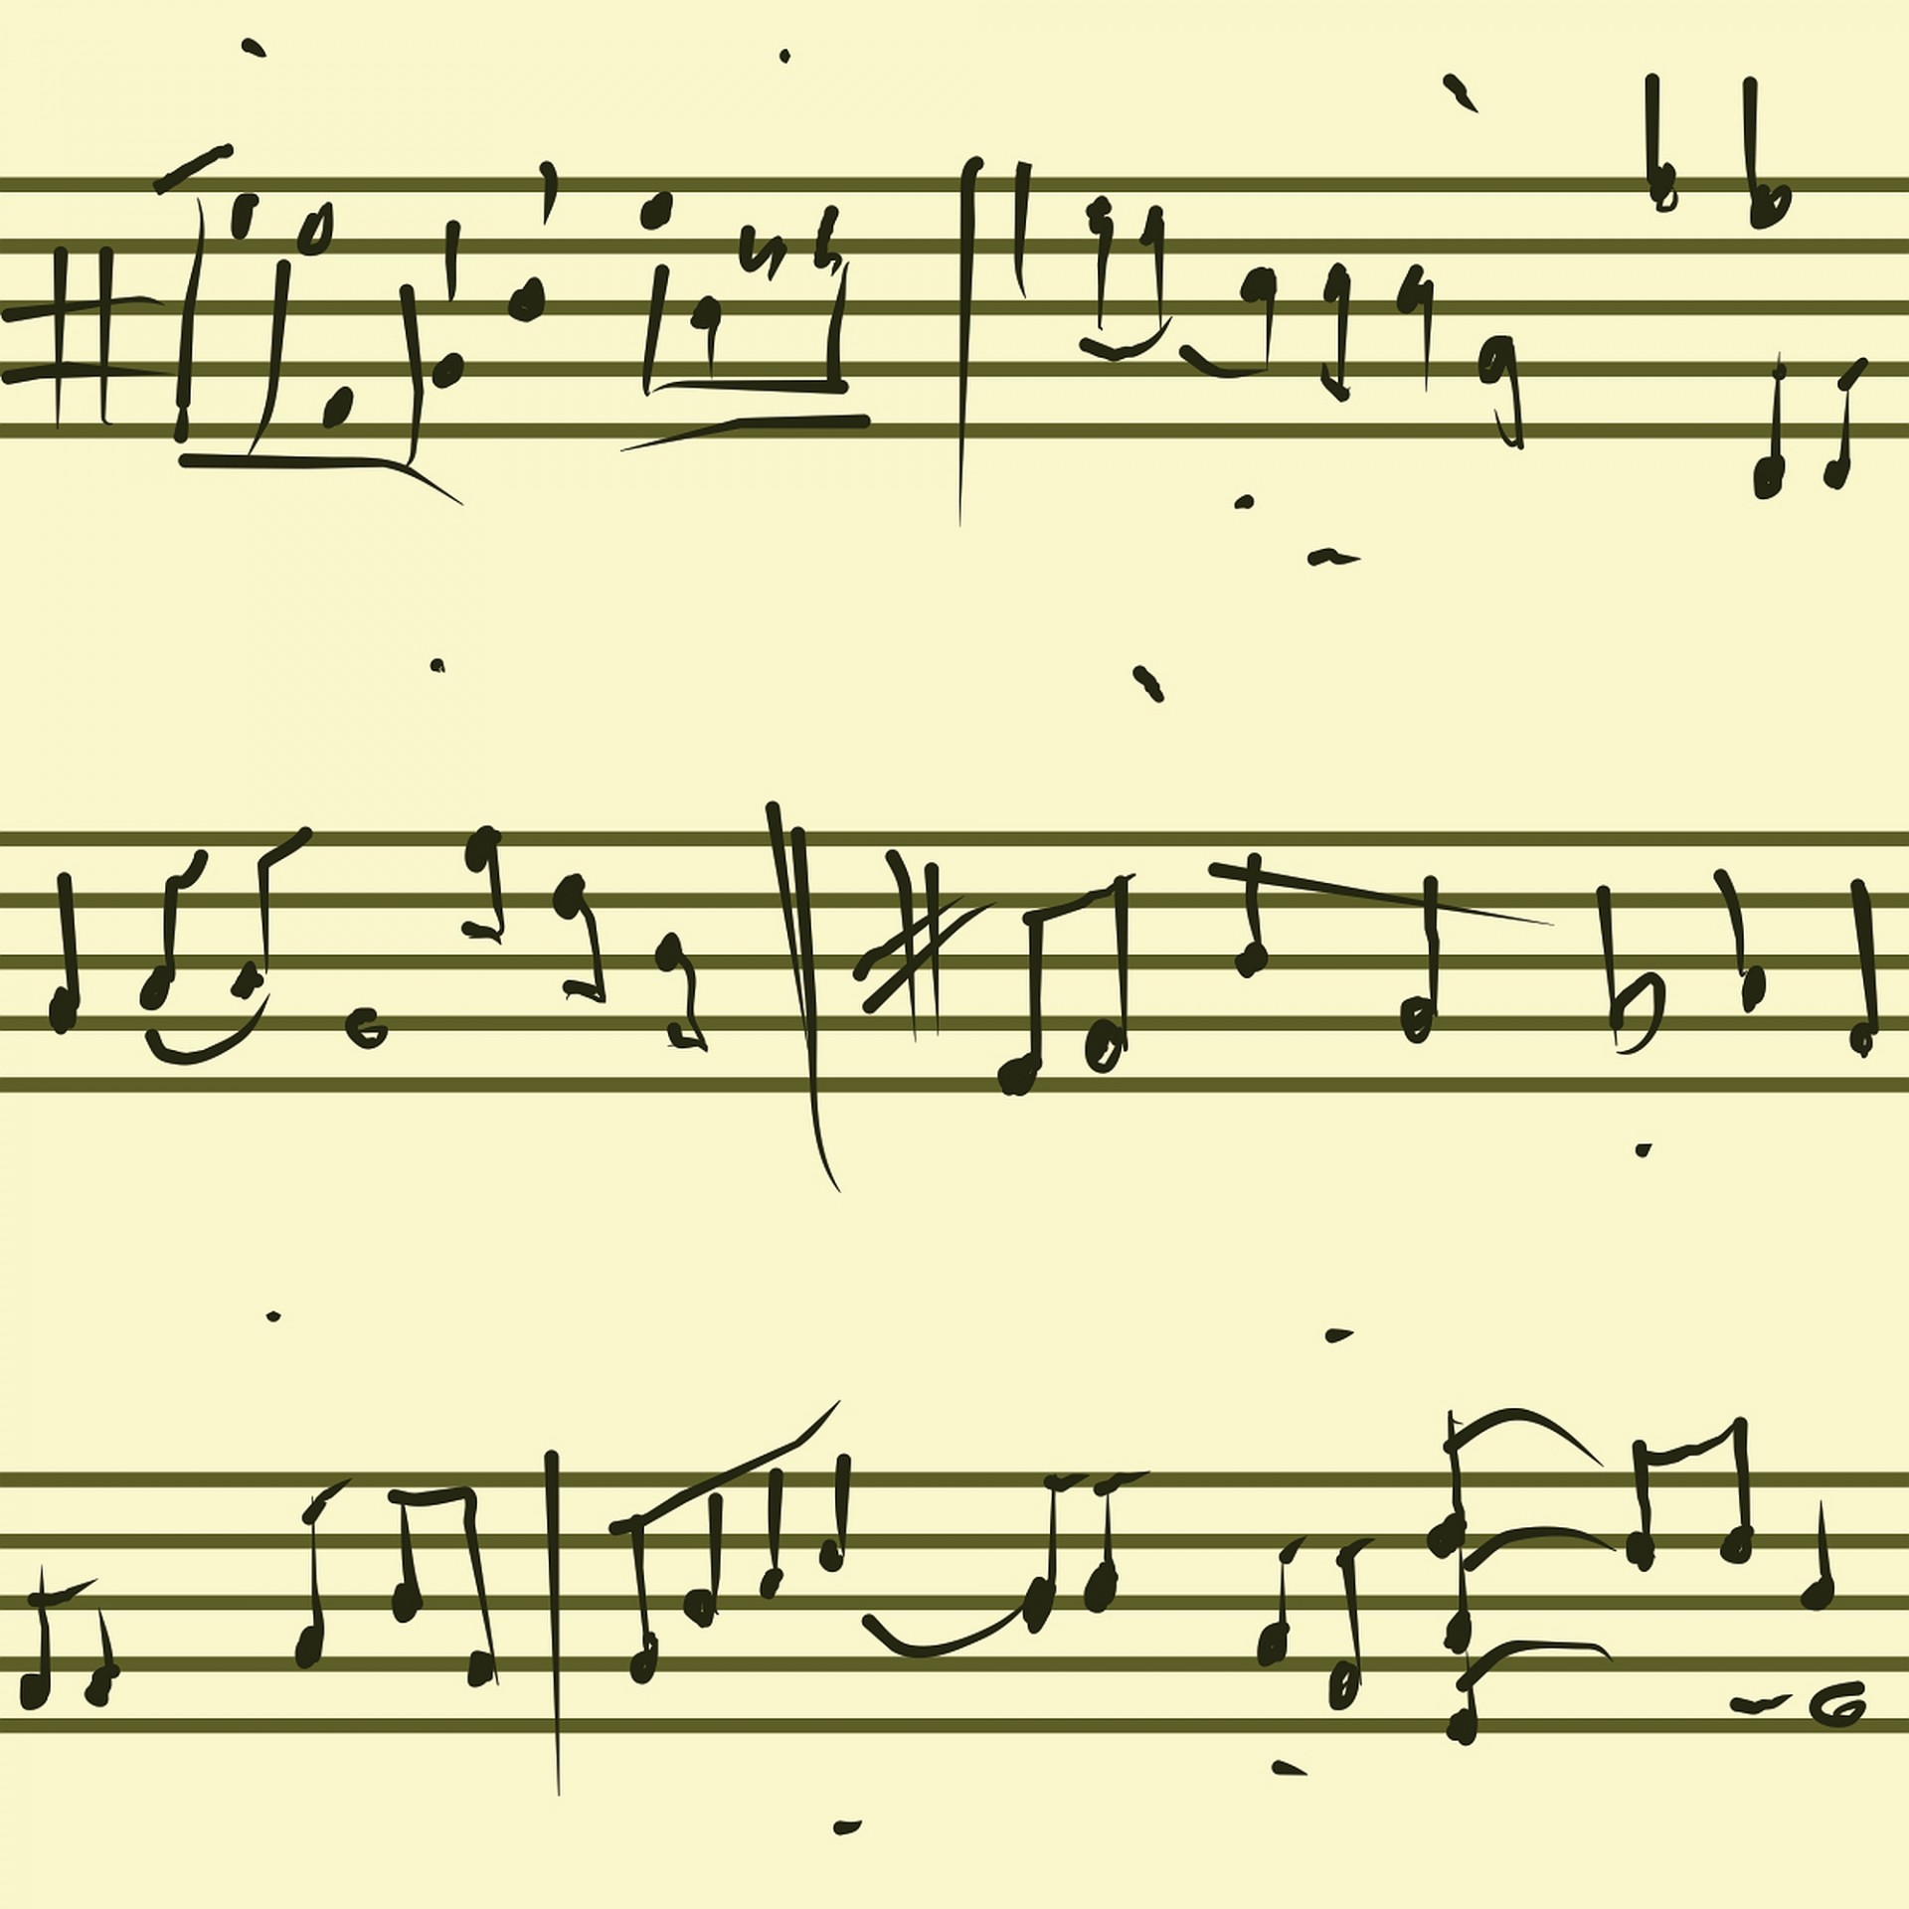
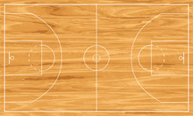
Summer Term 1 in Year 3
PSHE
Art
RE
French
We will be developing and designing a sculpture before creating a piece in the style of Andy Goldsworthy.
Our unit is religious buildings. We will be thinking about the value of places of worship in the community.
Our unit is 'Keeping Safe'. We will be learning about keeping safe and managing risks.
We will be learning about the family and household items.
Computing
Music
PE
Children will explore creating media. We will learn different types of skills used in desktop publishing along with improving our typing skills.
For more detailed information about the curriculum, please see the 'Curriculum' page on the school website.
We will be exploring tuned instruments. We will be learning how to play a range of notes, become familiar with written music and playing simple tunes.
Indoor PE – Cricket
Outdoor PE – Basketball

