Slide 1
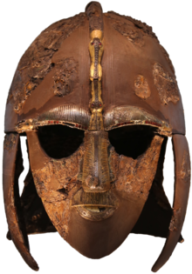
Summer Term 1 in Year 5
Welcome back!
Our topic for this half term is the Invaders and Settlers (Anglo Saxons).
Dates for your diaries:
Tuesdays – indoor PE
Wednesdays – outdoor PE
Trips:
Climate Change activities and Amersham Field Studies Centre 18/04/24
River Misbourne Geography trip 5HM 23/04/24 5WM 24/04/24
English
Maths
In class we will be reading the books:
Beowulf by Michael Morpurgo
Viking Boy by Tony Bradman
Writing lessons will focus on varying sentence structures, subordinate and relative clauses, parenthesis, speech punctuation, paragraphs, imagery and changing tense appropriately.
We will be writing kenning poetry, a diary entry, a newspaper report, a formal letter to persuade and battle commentary
This half term we will focus on:
Geometry
Shape, Position and Direction
Number
Four operations with decimals and negative numbers
Measurement
Converting units of length, time and volume
History
Homework
Spelling – 5 words from the list each week written in sentences. There is also a list of spelling words at the front of the book to practice ahead of a test later this term.
Science
We will be returning to British history with the arrival of Anglo-Saxons, discussing their invaders and settlers. Their culture and struggles leading up to the arrival of the Vikings.
Our next science unit ‘Life cycles & reproduction’
study and compare the life cycles of the various animal groups – mammals, birds, reptiles, amphibians and fish.
Reading logged on BoomReader a minimum of 3 times a week – at least once should be by an adult who has heard them read aloud.
MyMaths as normal
Google classroom – presentation- details to follow

Slide 2
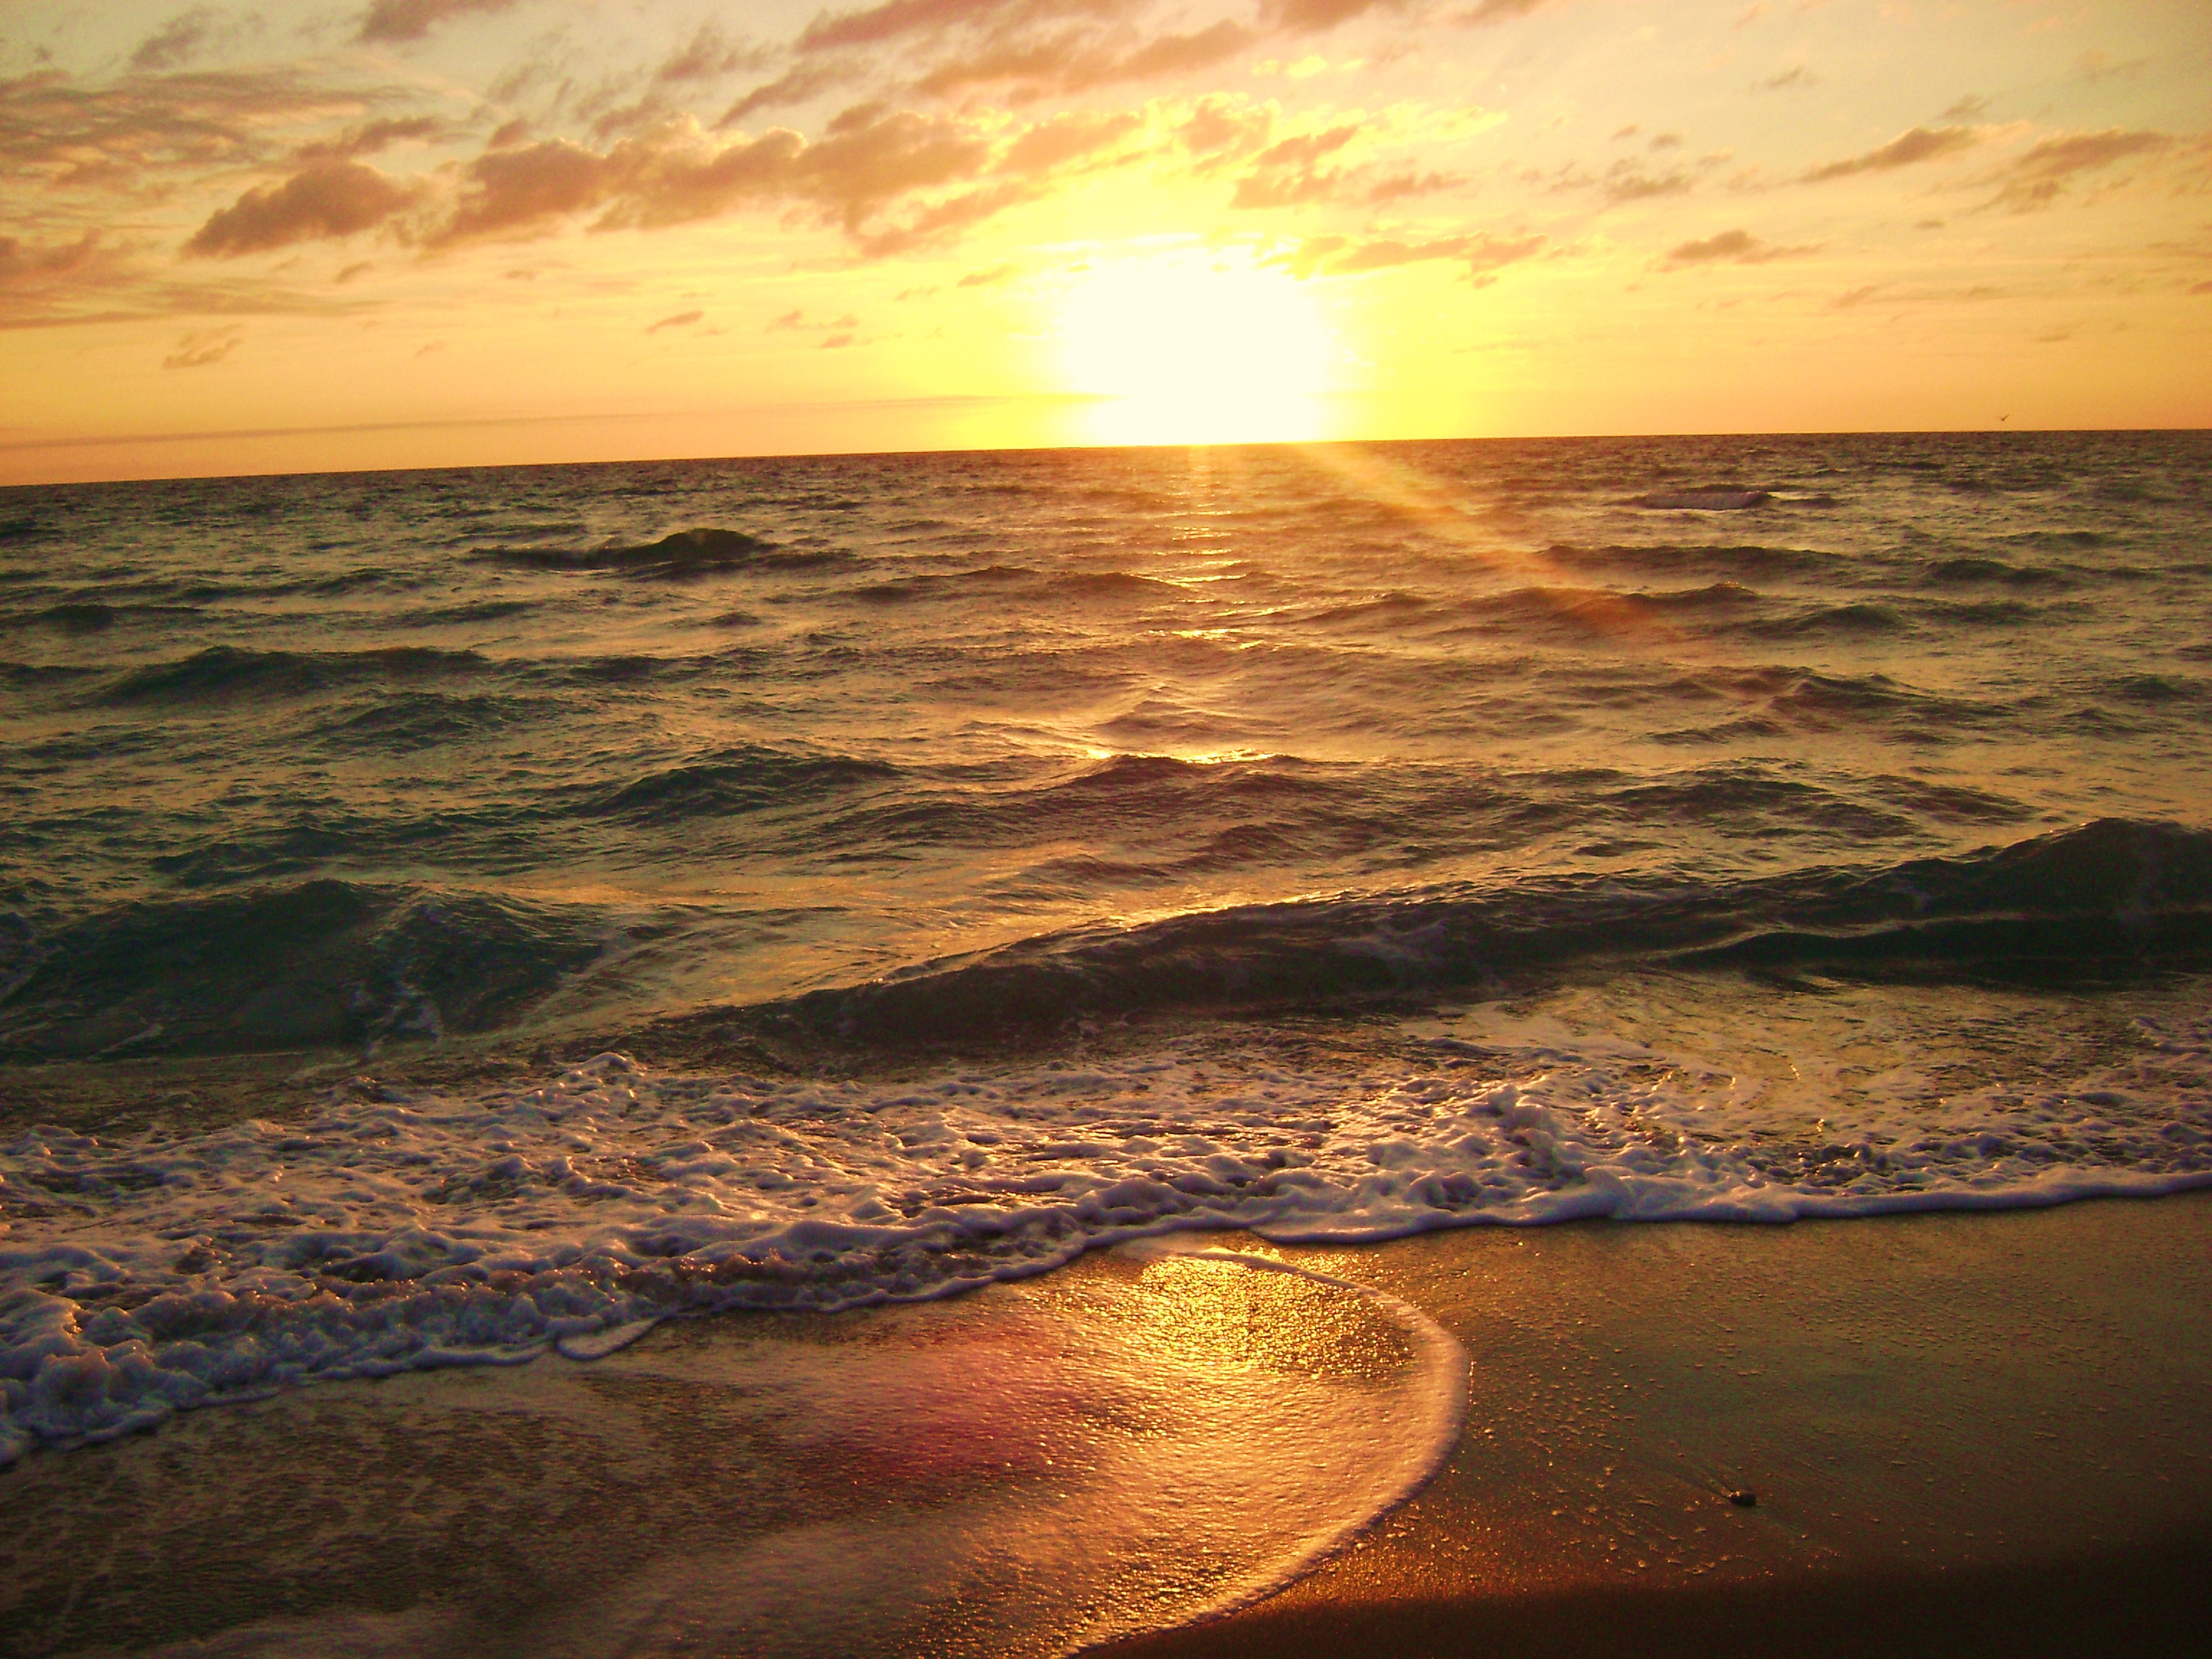
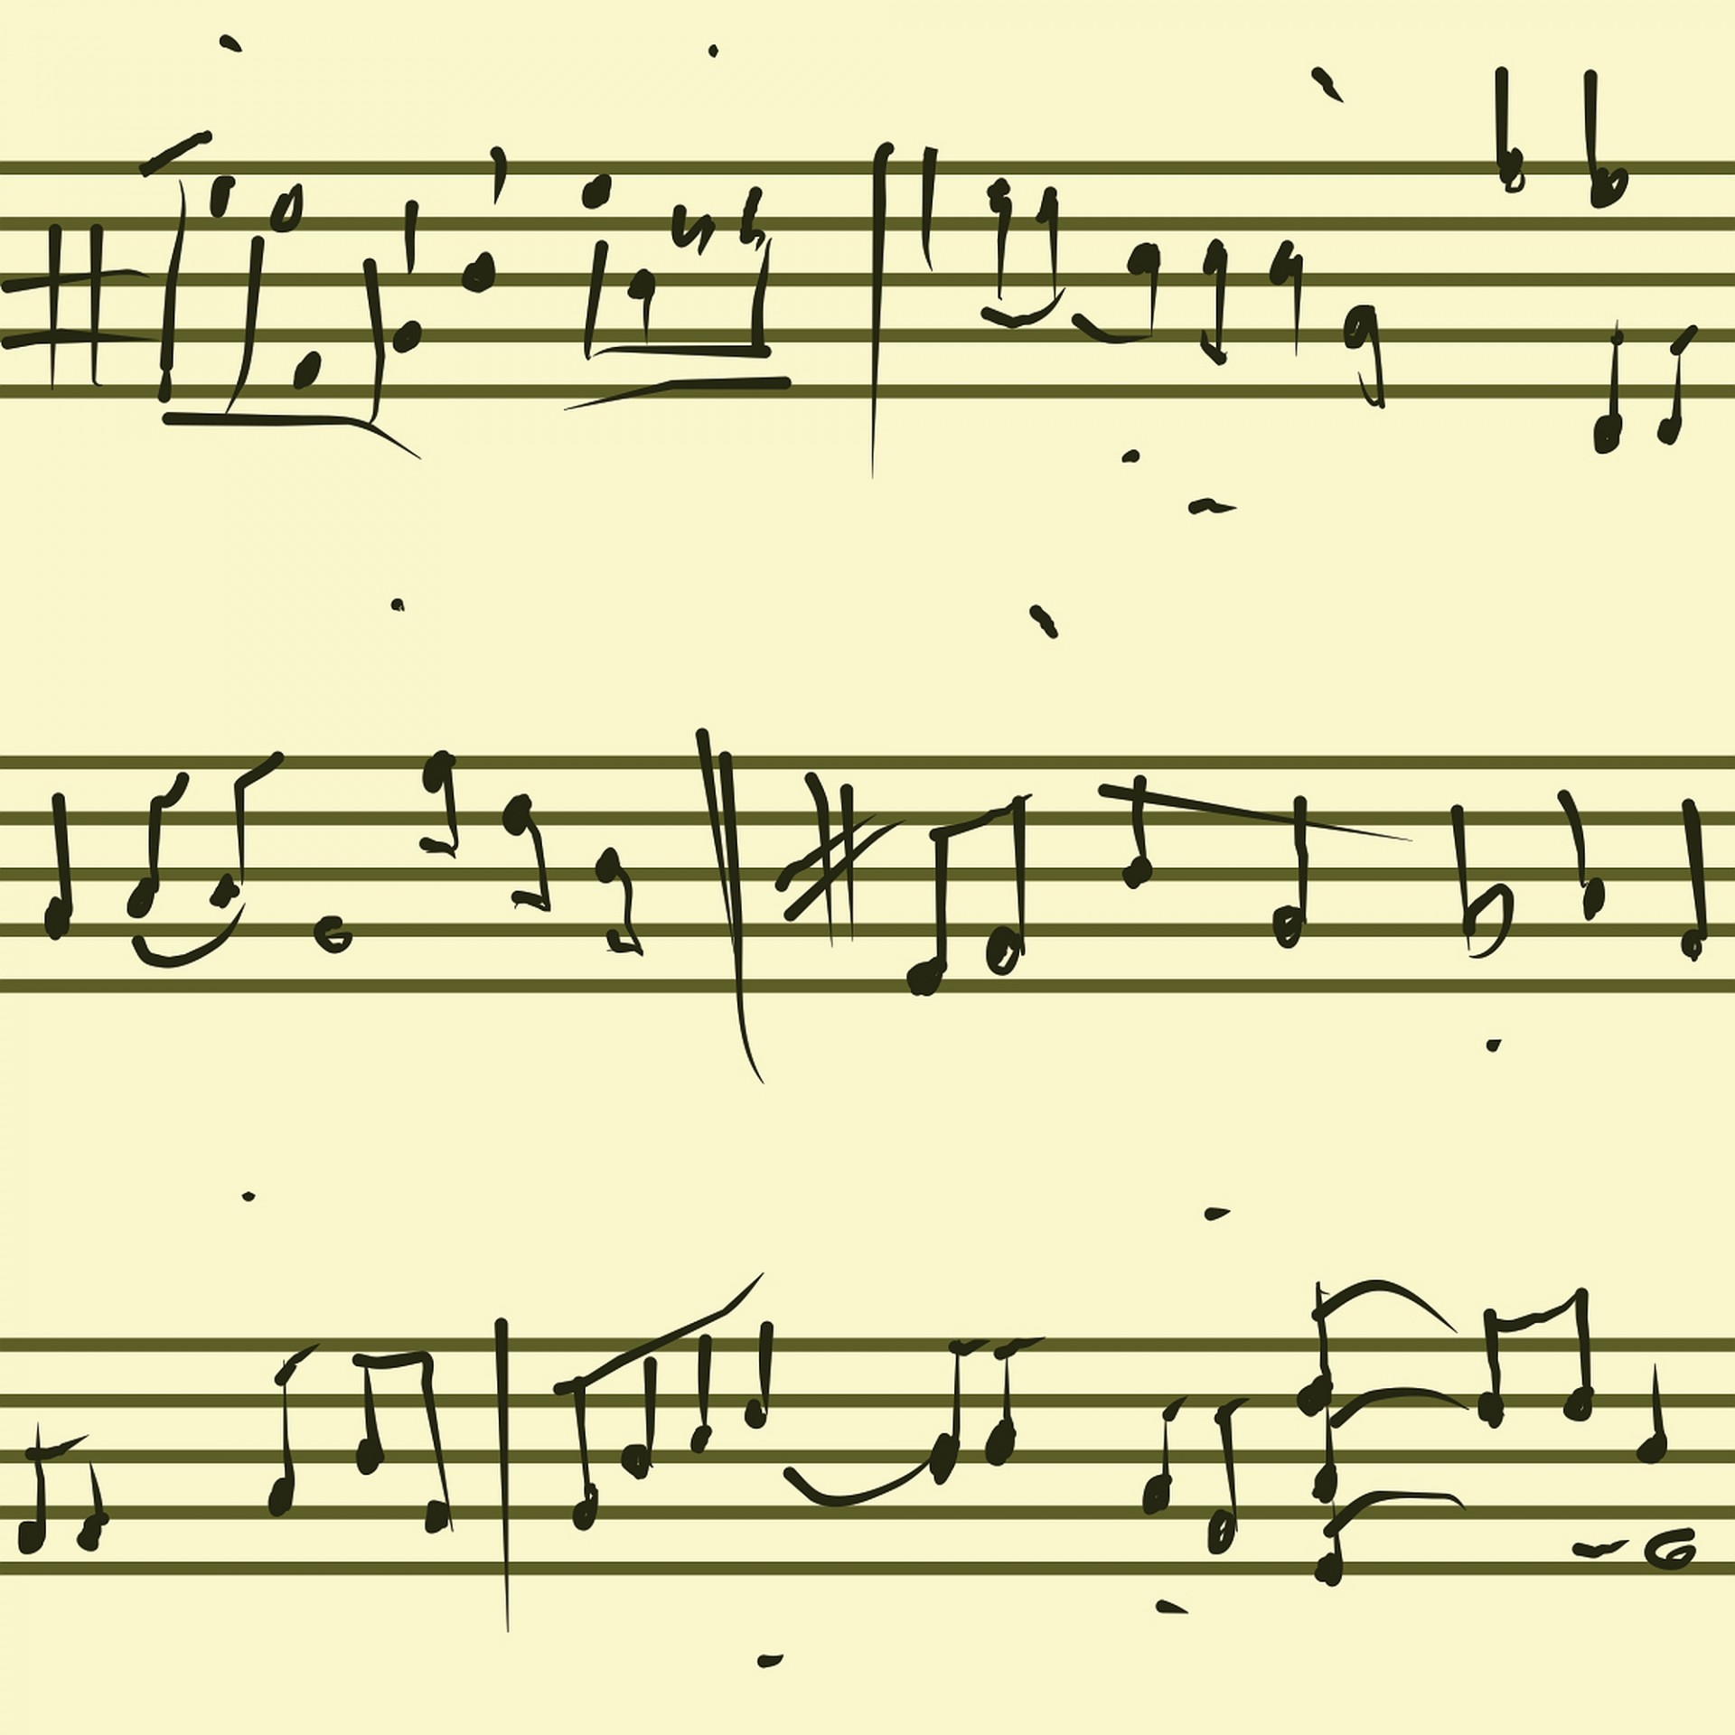
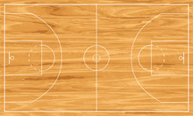
Summer Term 1 in Year 5
PSHE
DT
RE
French
Our unit is ‘Keeping safe’
Key themes include;
Bullying, levels of risks, dares and health including discussion about the effects of smoking/vaping.
The children will be designing and creating a moving cam toy using the following tools under supervision to construct their cam toy: ruler, a small hacksaw, glue gun, sandpaper, a vice and scissors
We will be discussing why pilgrimage is so important to some religious communities.
The children will be learning to describe their holidays.
‘En vancances’
Computing
Music
PE
This term we will be creating media in the form of web page creation using Google Sites.
The website will be for a specific purpose with a cross-curricular link, paying specific attention to copyright and fair use of media, the aesthetics of the site, and navigation paths.
For more detailed information about the curriculum, please see the 'Curriculum' page on the school website.
This term the children will be exploring a tuned percussion instrument – the glockenspiel and learning read musical notation.
Indoor PE (field when dry) –
Athletics skills; running, jumping and throwing with increased speed, height, distance or accuracy.
Outdoor PE –
Rounders – bowling, backstop, batting and fielding tactics.

