Slide 1
Summer Term 1 in Year 4
English
Maths
Welcome back!
Our topic for this half term is ‘Ancient Rome’
Dates for your diaries:
PE days – Wednesdays and Thursdays.
29.4.24 – Frisbee Festival at Amersham School (9.15-10.30am)
9.5.24 – Fieldwork at Mop End, Amersham (all day).
6.6.24 Boogie bounce at Amersham School.
Some of the books which will inspire our writing will be:
Romulus and Remus, Survivor: Escape from Pompeii and Roman Invasion: A British Boy (Diary)
We will be completing a series of writing tasks, including newspaper articles, balanced arguments, instructions, character profiles and monologues.
In Maths, we will be continuing our study of decimals (to hundredths) and including partioning and comparing. We will then put this knowledge to use by starting a topic on money including practical problem solving. We will finish the half term with the topic of time, including converting between analogue and digital time.
Science
History
Our first science unit is ’ Sound’. We will investigate how sound is made, how it travels and how our ear functions to hear.
We will then look to see how sound can be manipulated (amplitude and pitch) and explore how sound can be measured.
This term we will be learning about the Ancient Romans. We will be looking at who the Romans were, how they lived, their legacy and their impact on Britain today.
Reading
Please ensure that all reading is logged on BoomReader a minimum of 3 times a week.

Slide 2
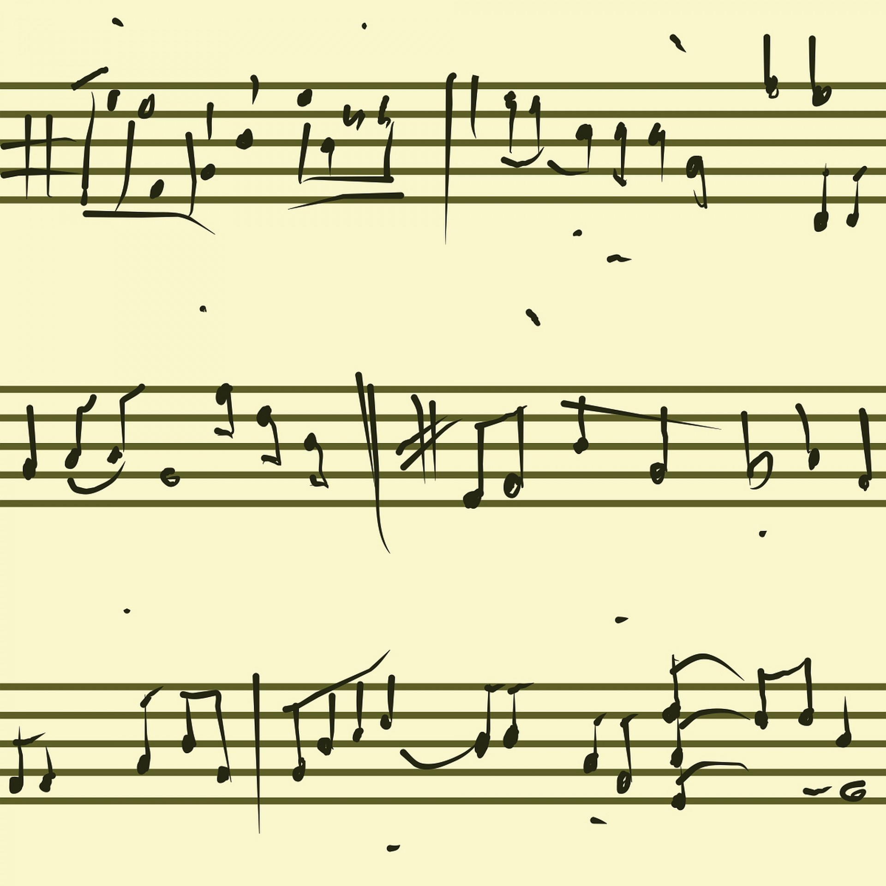
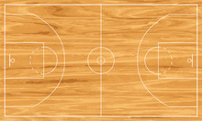
Spring Term 2 in Year 4
PSHE
Art
RE
French
We will be investigating pop art and looking at the work of Andy Warhol. The children will produce a final work using photo editing software.
We continue to think about worship, this time focusing our attention on Islam and how they show commitment to god.
Our unit is Keeping Safe.
We will be covering shopping, food and money in French this half term.
Computing
Music
PE
In computing, we will look at the acceptable use of digital material available online in ESafety. After completing this the children will embark on a course to learn photo editing skills.
For more detailed information about the curriculum, please see the 'Curriculum' page on the school website.
This term a specialist teacher will be teaching the children to play the ukulele with a focus on melody, chords and strumming rhythms.
Basketball and Rounders.

