Slide 1
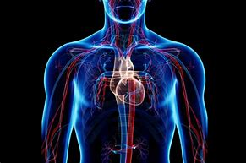
Summer Term 1 in Year 6
Welcome back!
Dates for your diaries:
Thursdays and Fridays – PE days
29th April - Personal Best Festival – Amersham School
Parent helpers please get in touch via dojo.
13th May – SATs week (breakfast each day provided)
w/c 20th May - Auditions for Yr 6 Production
24-28th June – Residential
w/c 1st July – Bikeability and Transition Day
English
Maths
Some of the books which will inspire our writing will be:
The Mysteries of Harris Burdick
By Chris Van Allsburg
The Arrival by Shaun Tan
Boy Giant by Michael Morpurgo
This half term we will focus on revising key learning in KS2. These will include the topics of:
Number
Formal methods of calculation
Shape
Geometry
Algebra
Science
Geography
Our science unit is …
The Circulatory System
Global Challenges
Our learning will build to us answering our Big Question: What issues is the world currently facing?
We will be covering issues such as climate change and displacement.
Reading
Please ensure that all reading is logged on BoomReader a minimum of 3 times a week (including one parent read).

Slide 2
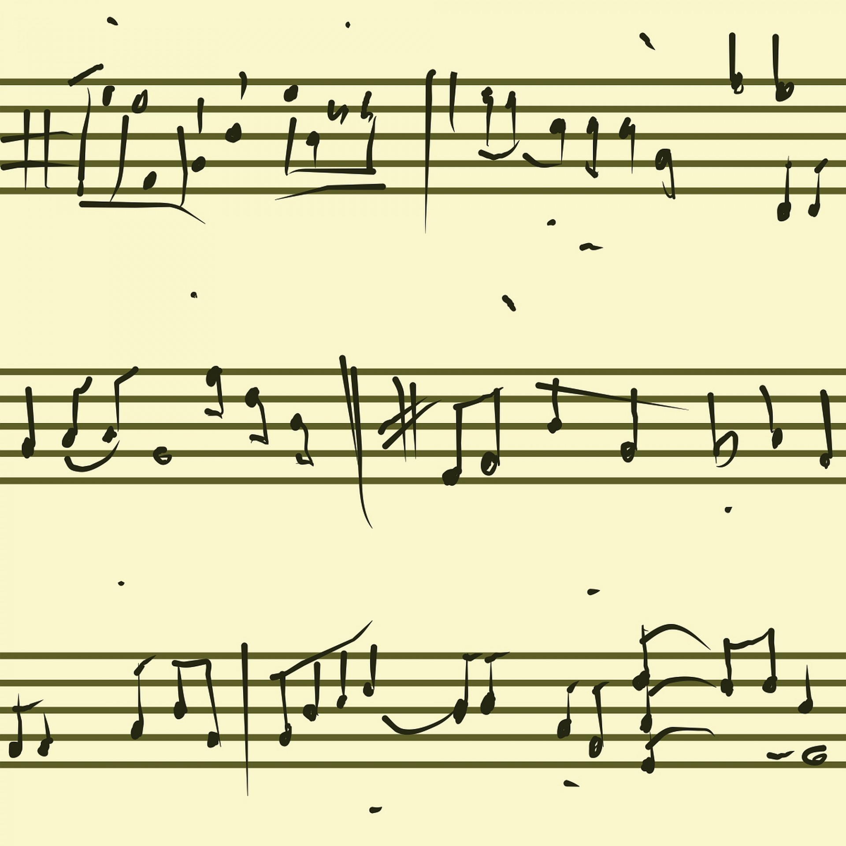
Summer Term 1 in Year 6
PSHE
ART
RE
French
Our unit is…
Keeping Safe
Sex and Relationship Education will take place in Summer 2. We will notify parents in advance.
Our unit is:
Diversity
Why don’t all members of community believe and live in the same way?
Printing
Inspired by William Morris
Pop Art
Inspired by Roy Lichtenstein
Our unit is called:
Les sports
Food and Greetings
Computing
Music
PE
Keyboard
&
Singing for Production
PE 1
Rounders
PE 2
Athletics
For more detailed information about the curriculum, please see the 'Curriculum' page on the school website.
Our unit is:
Creating Media - video

