Slide 1
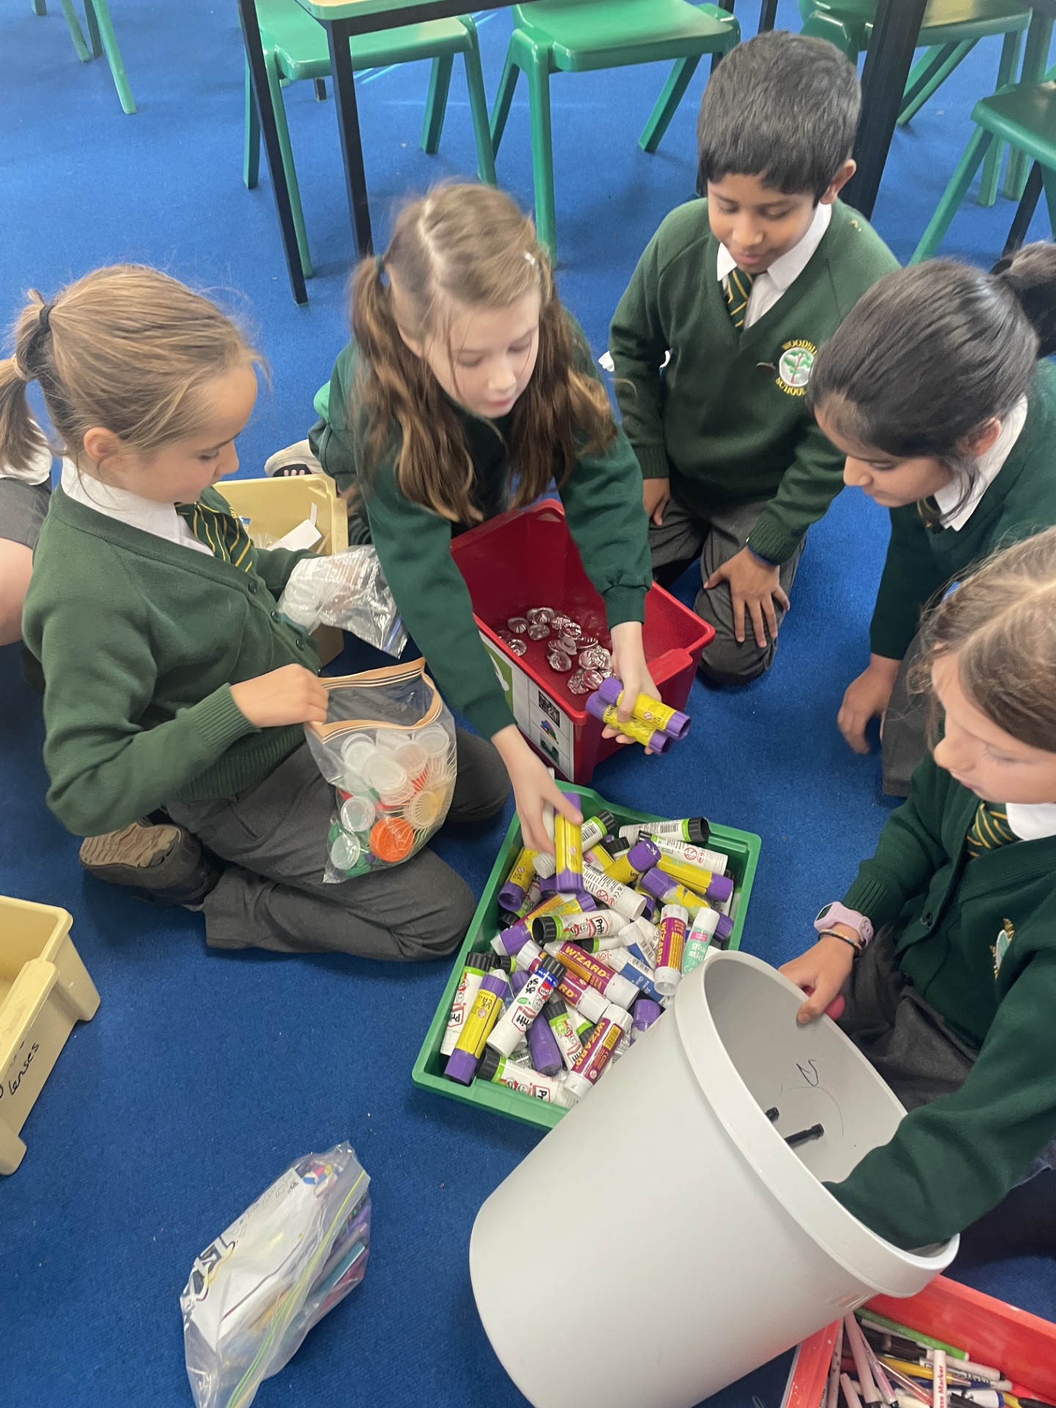
The Eco Council members are busy sorting the recycling that you put into the boxes in your classrooms.
Thank you for doing your bit to recycle items we use lots of in school.

